Slide 1

UNDERSTANDING
ECONOMIC POLICIES AND IMPACTS
BY Yasiru Prabodha
ID CL/OTHMFL3/11/90

Slide 2

Table of Content
01
MEASURES OF MONEY
02
02
MONETARY AND FISCAL POLICIES
04
03
GOVERNMENT USE OF INTEREST RATES
06
04
ECONOMIC IMPACTS OF INFLATION
07

Slide 3

Measures of Money
The money supply, commonly known as the "money stock," encompasses diverse financial assets used for exchanging goods, storing value, and measuring economic value. These assets are grouped into distinct levels or categories known as monetary aggregates.
M0 (BASE MONEY)
M1 (NARROW MONEY)
This is the most liquid form of money, consisting of physical currency (coins and notes) circulating in the economy and the reserves that commercial banks hold in their accounts at the central bank (also known as vault cash).
Includes M0 plus demand deposits (checking accounts) and other liquid assets that can be converted into cash easily and immediately.
02
Notes:
- Money supply measures help economists and policymakers understand liquidity conditions in the economy.
- Changes in money supply impact inflation, interest rates, and overall economic activity.

Slide 4

M2 (BROAD MONEY)
M3 (BROADEST MONEY)
This includes M1 plus savings deposits, time deposits (such as certificates of deposit), and money market mutual funds. M2 represents a broader measure of money that includes less liquid forms of savings.
This includes M2 plus large time deposits, institutional money market funds, and other larger liquid assets. M3 is the broadest measure of money supply.
These monetary aggregates help policymakers gauge the overall availability and circulation of money in the economy, which can influence economic growth, inflation, interest rates, and other macroeconomic variables.
03
Notes:
- Central banks monitor these measures closely to implement effective monetary policies.

Slide 5

Monetary and Fiscal Policies
MONETARY POLICY
CONTROLLER
Controlled by central banks or monetary authority.
GOALS
Manage inflation, stabilize currency, achieve full employment.
TOOLS
Open Market Operations: Buying and selling government securities to influence money supply.
Reserve Requirements: Setting the minimum reserves each bank must hold to ensure stability.
Discount Rate: Interest rate charged to commercial banks for borrowing funds from the central bank.
04
Notes:
Example: During the 2008 financial crisis, the Federal Reserve lowered interest rates and conducted quantitative easing, while the U.S. government passed stimulus packages to boost economic activity.

Slide 6

Fiscal Policy
EXECUTE
GOALS
TOOLS
Executed by national governments through budgetary tools.
Influence economic activity, redistribute income, fund public services
Taxation: Adjusting tax rates and tax incentives to influence consumer and business behavior.
Government Spending: Direct spending on infrastructure, education, defense, etc., to stimulate or cool down the economy.
Budget Deficits/Surpluses: Managing the balance between government revenue and expenditure.
05
Notes:
Context: These policies are used in tandem to achieve macroeconomic stability and growth.

Slide 7

Government Use of Interest Rates
Encouragement of Investment
Control of Inflation
Central banks raise interest rates to reduce borrowing and spending, cooling down an overheated economy.
Lower interest rates to stimulate borrowing and spending in a sluggish economy.
Lower interest rates reduce the cost of borrowing, encouraging businesses and consumers to invest and spend.
Higher rates can attract foreign investment, strengthening the currency.
06
Notes:
- Example: If inflation is high, central banks may increase interest rates to cool down the economy by making borrowing more expensive and saving more attractive.
- Context: Interest rates directly affect consumer spending, business investment, and overall economic growth.

Slide 8
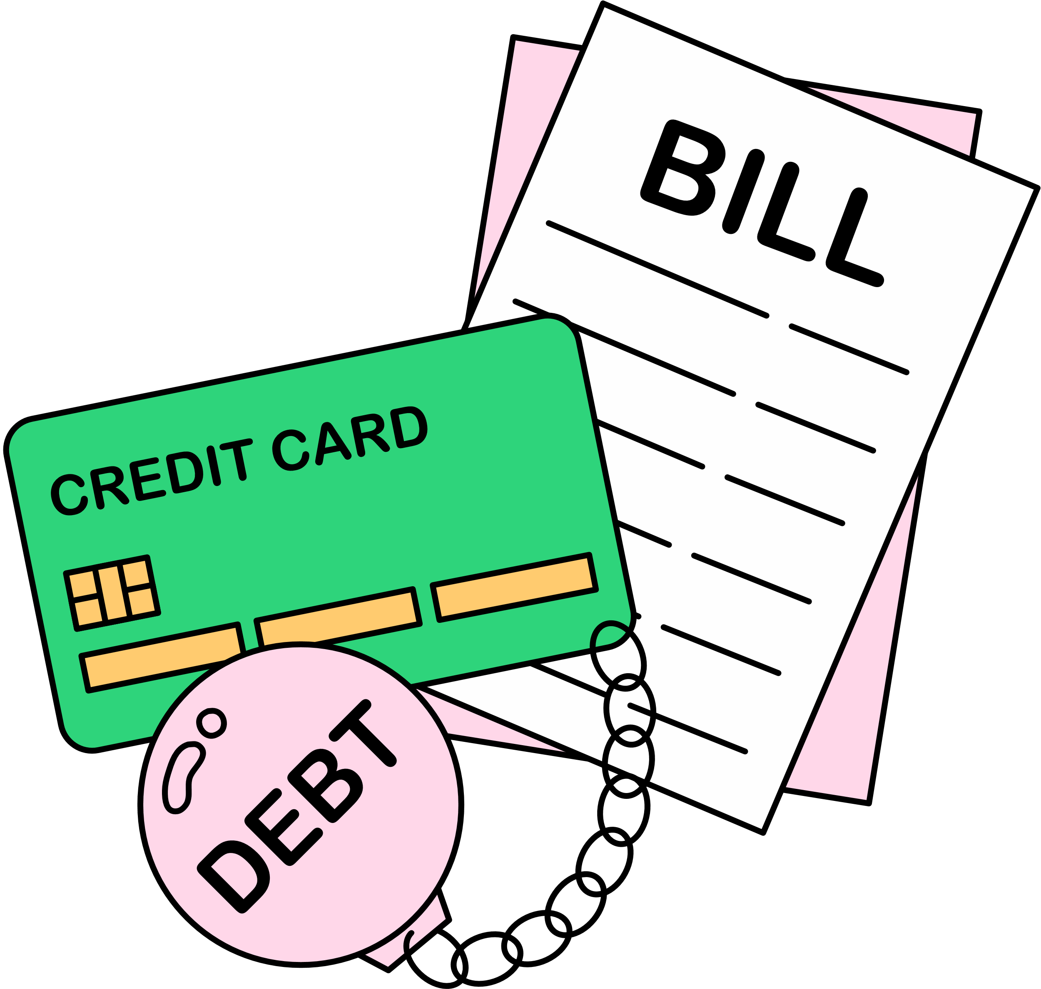
INCOME REDISTRIBUTION
EROSION OF PURCHASING POWER
Inflation can benefit debtors (who repay loans with cheaper money) and hurt creditors (who receive less valuable repayments)
Higher prices reduce the real value of money, meaning consumers can buy less with the same amount of money.
Economic Impacts of Inflation
UNCERTAINTY
MENU COSTS
High and unpredictable inflation can lead to uncertainty, reducing investment and economic growth.
Businesses incur costs from constantly changing prices to keep up with inflation.
07
Notes:
- Example: Hyperinflation in Zimbabwe during the late 2000s led to extreme economic instability and the collapse of the currency.
- Context: Moderate inflation (around 2%) is typically seen as a sign of a growing economy, whereas deflation (falling prices) can signal economic distress.

Slide 9

Thank You !
BY
Yasiru Prabodha
ID
cl/othmfl3/11/90

